Slide 1

SENG 8215: SOFTWARE ENGINEERING
1

Slide 2
Contacts
Name: Dr. GASHEMA Gaspard
Phone Number: 0786719429
Email:
ggas06@yahoo.fr
g.gashema@ur.ac.rw
allschoolsactivities@gmail.com
Most preferable: allschoolsactivities@gmail.com
https://scholar.google.com/citations?user=pKNk3y8AAAAJ&hl=en
https://aceiot.ur.ac.rw/?Gaspard-GASHEMA
https://www.linkedin.com/in/gaspard-gashema- 19056b59/

Slide 3
Lecturer 1: Introduction
3

Slide 4
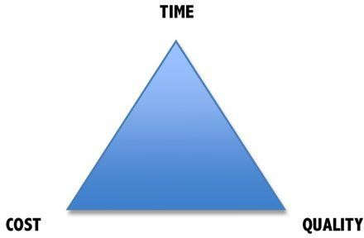
Why is Software Engineering important?
4
Complex systems need a disciplined approach for designing, developing and managing them.

Slide 5
Why Software Engineering?
Software development is hard !
Important to distinguish “easy” systems (one developer, one user, experimental use only) from “hard” systems (multiple developers, multiple users, products)
Experience with “easy” systems is misleading
– One person techniques do not scale up

Slide 6
Why Software Engineering ?
The problem is complexity
Many sources of complexity, but size is key:
UNIX contains 4 million lines of code
Windows 2000 contains 10⁸ lines of code
Software engineering is about managing
this complexity.

Slide 7
Goals of Software Development
• Satisfy users requirements.
• High reliability.
• Low maintenance costs.
• Delivery on time.
• Low production costs.
• High performance.
• Ease of reuse

Slide 8
Software Development Crises
7
Projects were:
Late.
Over budget.
Unreliable.
Difficult to maintain.
Performed poorly.

Slide 9
8
Software errors….the cost
Errors in computer software can have devastating effects.

Slide 10

Software Crisis
9
Example 1: 2009,Computer glitch delays flights
Saturday 3rd October 2009-London, England (CNN)
Dozens of flights from the UK were delayed Saturday after a glitch(a sudden, usually temporary malfunction or irregularity of equipment) in an air traffic control system in Scotland, but the problem was fixed a few hours later.
The agency said it reverted (returned) to backup equipment as engineering worked on the system.
The problem did not create a safety issue but could cause
delays in flights.
Read more at: http://edition.cnn.com/2009/WORLD/europe/10/03/uk.fl ights.delayed

Slide 11
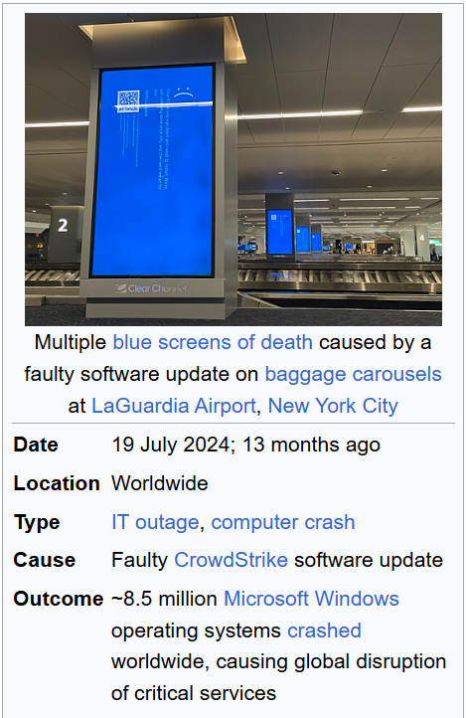
Software Crisis
9
Example 1: 2024 CrowdStrike-related IT outages
On 19 July 2024 at 04:09 UTC, CrowdStrike released a content configuration update (via its Falcon sensor) for Windows hosts.
The update involved Channel File 291, part of the Rapid Response Content that’s meant to help detect or mitigate threats.
There was a logic error in this update. Specifically, a mismatch between defined input fields in a template type and what the sensor actually provided led to an out-of-bounds memory read — ultimately causing Windows machines with that update to crash (blue screen) or get stuck in a boot loop.
Read more at: https://en.wikipedia.org/wiki/2024_CrowdStrike-related_IT_outages

Slide 12
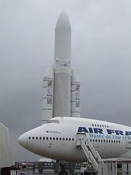
Software Crisis
10
Example 2: Ariane 5 Explosion on June 4, 1996
(Most commonly refers to the failure of Ariane 5 Flight 501)
European Space Agency spent 10 years and $7
billion to produce Ariane 5.
Crash after 36.7 seconds after liftoff due to a software error in its Inertial Reference System (IRS).
Caused by an overflow error. Trying to store a 64-bit
number into a 16-bit space. The error, a data conversion failure, caused the IRS to stop functioning, leading to a loss of guidance and attitude information, which then caused an angle of attack exceeding 20 degrees and the subsequent destruction of the rocket.
Watch the video: http://www.youtube.com/watch?v=z-r9cYp3tTE

Slide 13
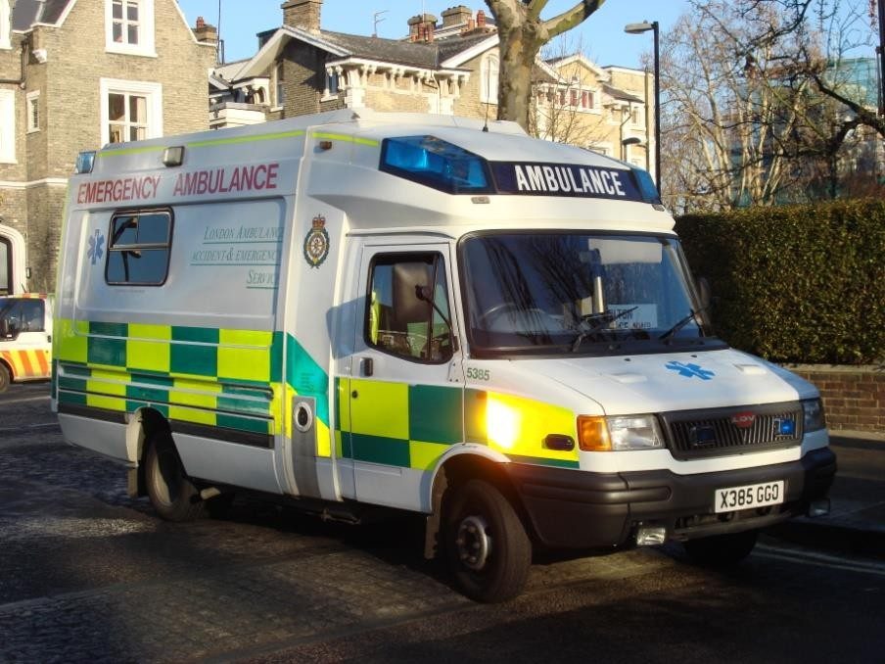
Software Crisis
11
Example 3: 1992, London Ambulance Service
Considered the largest ambulance service in the
world.
Overloaded problem.
It was unable to keep track of the ambulances and their statuses. Sending multiple units to some locations and no units to other locations.
Generates many exceptions messages.
46 deaths.
Read more: https://www.wired.com/2009/10/1026london-ambulance-computer-meltdown/

Slide 14
Therefore…
12
A well-disciplined approach to software development and management is
necessary. This is called engineering.

Slide 15
Software Engineering
13
The term software engineering first appeared in the 1968 NATO Software Engineering Conference and was meant to provoke thought regarding what was then called the “software crisis”..
https://en.wikipedia.org/wiki/NATO_Software_Engineering_Conferences
https://www.scrummanager.com/files/nato1968e.pdf
“.. An engineering discipline that is concerned with all aspects of software production from the early stages of system specification to maintaining the system after it has gone into use.” Sommerville, pg.7
Notes:
To provoke thought: to stimulate or cause someone to think deeply about a subject by introducing new ideas, challenging assumptions, or raising questions that encourage reflection and critical analysis.

Slide 16








What is Software?
14
Programs
Software
System Documentation
Data
Documentation
User
Documentation

Slide 17



What is software? (cont..)
Computer programs and associated documentation
Software products may be developed for a particular customer or may be developed for a general market
Software products may be
Generic - developed to be sold to a range of different customers
Bespoke (custom) - developed for a single customer according to their specification
15

Slide 18
Types of Software
16
Generic products.
Stand-alone systems that are marketed and sold to any customer who wishes to buy them.
Examples – PC software such as graphics programs, project management tools; CAD software; software for specific markets such as appointments systems for dentists.
The specification of what the software should do is owned by the software developer and decisions on software change are made by the developer.
Customized or bespoke products.
Software that is commissioned by a specific customer to meet their own needs.
Examples – embedded control systems, air traffic control software, traffic monitoring systems.
The specification of what the software should do is owned by the customer for the
software and they make decisions on software changes that are required.

Slide 19

Software Engineering vs. Computer Science
17
“Computer science is no more about computers than astronomy is about telescopes.” Edsger Dijkstra
Computer Science
Software Engineering
Theory.
Fundamentals.
Practicalities of software design, development and delivery.

Slide 20
Software Engineering vs. Computer Science……
17
Briefly, Computer Science focuses on the theoretical principles of computation, algorithms, and how computers work, whereas Software Engineering applies these principles to the practical design, development, testing, and maintenance of large-scale software systems.
Choosing between them depends on your interest in theory (Computer Science) versus practical, hands-on development of software products (Software Engineering).

Slide 21
Software Engineering vs. Systems Engineering
Systems Engineering:
Interdisciplinary engineering field (computer, software, and process eng.).
Focuses on how complex engineering projects should be designed and managed.
Systems Engineering
Software Engineering
All aspects of computer- based systems development: HW + SW + Process.
Older than SWE.
Deals with the design, development and delivery of SW.
Is part of Systems
Engineering.
Software engineers should
adopt a systematic and organized approach to their work
–use appropriate tools and techniques depending on
the problem to be solved,
the development constraints and the resources available

Slide 22
Frequently asked questions about software engineering
Question | Answer
What is software? | Computer programs and associated documentation. Software products may be developed for a particular customer or may be developed for a general market.
What are the attributes of good software? | Good software should deliver the required functionality and performance to the user and should be maintainable, dependable and usable.
What is software engineering? | Software engineering is an engineering discipline that is concerned with all aspects of software production.
What are the fundamental software engineering activities? | Software specification, software development, software validation and software evolution.
What is the difference between software engineering and computer science? | Computer science focuses on theory and fundamentals; software engineering is concerned with the practicalities of developing and delivering useful software.
What is the difference between software engineering and system engineering? | System engineering is concerned with all aspects of computer-based systems development including hardware, software and process engineering. Software engineering is part of this more general process.
19

Slide 23
Frequently asked questions about software engineering
Question | Answer
What are the key challenges facing software engineering? | Coping with increasing diversity, demands for reduced delivery times and developing trustworthy software.
What are the costs of software engineering? | Roughly 60% of software costs are development costs, 40% are testing costs. For custom software, evolution costs often exceed development costs.
What are the best software engineering techniques and methods? | While all software projects have to be professionally managed and developed, different techniques are appropriate for different types of system. For example, games should always be developed using a series of prototypes whereas safety critical control systems require a complete and analyzable specification to be developed. You can’t, therefore, say that one method is better than another.
What differences has the web made to software engineering? | The web has led to the availability of software services and the possibility of developing highly distributed service-based systems. Web-based systems development has led to important advances in programming languages and software reuse.
20

Slide 24
What is a Software Process?
21
Activities and results that produce a software product:
SW Process Activity | What is going on there?
Specification | What does the customer need? What are the constraints?
Development | Design & programming.
Validation | Checking whether it meets requirements.
Evolution | Modifications (e.g. customer/market).

Slide 25
What is a Software Process?
21
Activities and results that produce a software product:
SW Process Activity | What is going on there?
Specification | What does the customer need? What are the constraints?
Development | Design & programming.
Validation | Checking whether it meets requirements.
Evolution | Modifications (e.g. customer/market).

Slide 26
What is a software process?
SP is a set of activities whose goal is the development or evolution of software
Fundamental activities in all software processes are:
Specification - what the system should do and its development constraints
Development - production of the software system (design and implementation)
Validation - checking that the software is what the customer wants
Evolution - changing the software in response to changing demands

Slide 27
Requirement VS specification.
Item | Requirement | Specification
Dictionary | Something that is needed | A precise description of an item.
Project management arena | A customer need | A detailed, usually technical description of how that need will be met
Example | If an airline wants a plane that will fly 800 passengers from Los Angeles direct to Tokyo, that is a requirement | When the manufacturer designs an aircraft of certain dimensions powered by four engines of certain horsepower, that is a specification

Slide 28
Software Process
Process consists of activities/steps to be carried out in a particular order
SP deals with both technical and mgt issues
Consists of different types of process
Process for software development:
Produces software as end-results
Multiple such processes may exist
Project follows a particular process

Slide 29
Process types
Process for managing the project
Defines project planning and control
Effort estimations made and schedule prepared
Resources are provided
Feedback taken for quality assurance
Monitoring done

Slide 30
Process types…
Process for change and configuration mgt
Resolving request for changes
Defining versions and their compositions
Release control
Process for managing the above processes themselves:
Improving the processes based on new techniques, tools, tec..
Standardizations and Certifications (ISO, CMM)
Capability Maturity Model (CMM) : CMM levels play an important role in an organization's Quality Assurance effort. Thus, testing plays an important role in determining CMM level

Slide 31
Multiple processes
A large s/w development company may have multiple development processes:
For client/server based conventional application (sales processing, payroll,..)
For enterprise-level (ERP) Project based on packages and customization
For web-based, ecommerce type
For data-warehouse / decision support type
The company may have many project in each category

Slide 32
Step in a Process
Each step has a well-defined objective
Require people with specific skills
Tasks specific inputs and produces well- defined outputs
Step defines when it may begin (entry criteria) and when it ends (exit criteria)
Uses specific techniques, tools, guidelines, conventions.

Slide 33
Step Process ..
Step must be executed as per project plan that gives duration effort, resources,
constraints, etc…
It must produce Information for mgt so that corrective actions can be taken (Adding more resources)

Slide 34
Step process..
A step ends in review (V&V)
Verification: Check consistency of outputs with inputs of the step
Validation: Check consistency with user needs

Slide 35
Verification
Verification refers to the set of activities that ensure that software correctly implements a specific functions. Acc. To Boehm [Boe81]
“Are we building the product right”
Validation
Validation refers to a different set of activities that ensures that the software that has been built is traceable to customer requirements. Acc. To Boehm [Boe81]
“Are we building the right product”

Slide 36
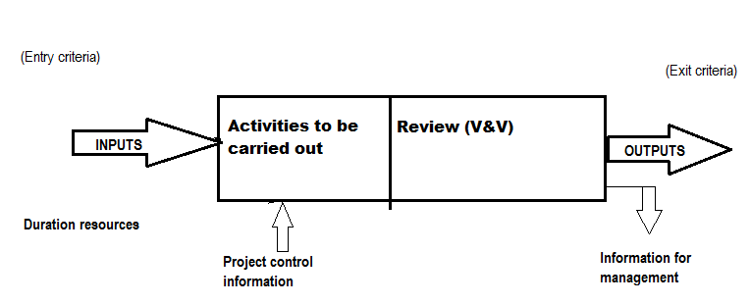
Process step - schema

Slide 37
Characteristics of a Good Process
Should be precisely defined
No ambiguity about what is to be done. When, how, etc,…
It must be predictable (Expected)
Can be repeated in other projects with confidence about its outcome
Predictable with respect to effort, cost
Predictable for quality: with respect to number and
type defects, performance,…

Slide 38
Characteristics of a Good Process…
Predictable process is said to be “under statistical control” where actual values are close to expected values (What to achieve in time, effort…).
It supports testing and maintainability
Maintenance
Follow standards and provide necessary documentation
This characteristics differentiate between prototype and product
p

Slide 39
Characteristics of a Good Process…
Facilitates early detection of and removal of defects
Defects add to project cost
Late detection/ correction is costly
It should facilitate monitoring and improvement
Based on feedback
Permit use of new tools and techniques
Permit measurements (Evaluation Improvement.

Slide 40
What is a software process model?
SPM is a simplified representation of a software process,
presented from a specific perspective
Examples of process perspectives:
Workflow perspective
Data-flow perspective
represents inputs, outputs and dependencies
represents data transformation activities
Role/action perspective represents the roles/activities of the
people involved in software process
Generic process models
Waterfall
Evolutionary development
Formal transformation
Integration from reusable components

Slide 41

What is CASE ?
(Computer-Aided Software Engineering)
Software systems which are intended to provide automated support for software process activities, such as requirements analysis, system modelling, debugging and testing
Upper-CASE
Tools to support the early process activities of requirements and design
Lower-CASE
Tools to support later activities such as programming, debugging and testing.

Slide 42
What are the attributes of good software?
The software should deliver the required functionality and performance to the user and should be maintainable, dependable and usable
Maintainability
Software must evolve to meet changing needs
Dependability
Software must be trustworthy (reliable)
Efficiency
Software should not make wasteful use of system resources
Usability: Software must be usable by the users for which it was designed.

Slide 43
What is a Software Process Model?
22
🟆 Description of the software process that represents one view, such as the activities, data or roles of people involved.
Examples of views | Focus on…
Workflow | Activities = human actions. What is input, output, and dependencies.
Dataflow | Activities = transformations of information. How the input is transformed into output.
Role/Action | What is the role of people involved in each step of the process?

Slide 44
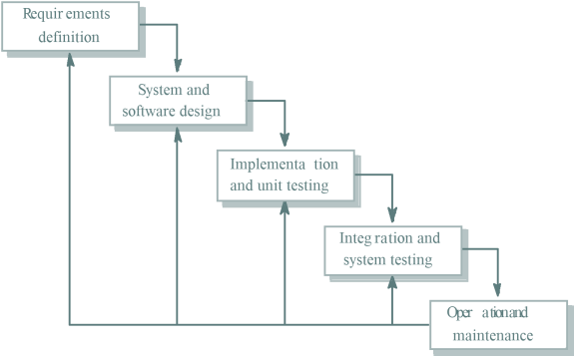
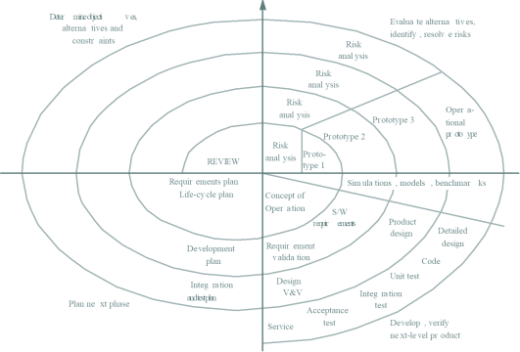
Software Process Models
23
Waterfall approach | Iterative development | Component-Based Software Engineering CBSE
 |  | assembled form existing components

Slide 45
The Cost of Software Engineering
24
🟆 Depends on:
🟆 The process used, and
🟆 The type of software being developed.
🟆 Each generic approach has a different profile of cost distribution.
🟆 Roughly 60% of costs are development costs, 40% are testing costs.
🟆 For custom software, evolution costs often exceed development costs.

Slide 46
Costs of software engineering?
Depends on:
The process used, and
The type of software being developed.
Each generic approach has a different profile of cost distribution
Roughly 60% of costs are development costs, 40% are testing costs. For custom software, evolution costs often exceed development costs
Costs vary depending on the type of system being developed and the requirements of system attributes such as performance and system reliability
Distribution of costs depends on the development model that is used.

Slide 47
25
Cost distribution
Custom software development (Bespoke)
Software Model Cost units
Cost distribution
Software development activity
Waterfall Model
0
25
50
75
100
Specification
Design
Development
Integration and testing
Iterative Development
0 25
50
75
100
Specification Iterative Development
Component-based Software Engineering
0 25 50
System testing
75
100
Specification
Development
Integration and testing
Development and evolution costs for long-lifetime systems
0 | 100 | 200 | 300 | 400
System development |  | System evolution

Slide 48
26
Cost distribution
Generic software development
0
25
50
75
100
Specification
Development System testing
Product development costs

Slide 49
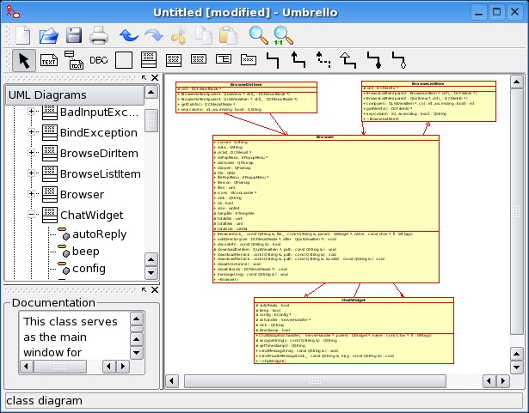
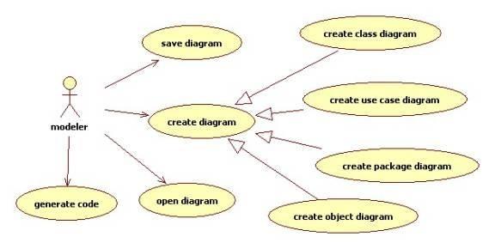
What is CASE?
27
🟆 Computer Aided Software Engineering.
🟆 Programs that support:
🟆 Requirements analysis.
🟆 System modeling.
🟆 Debugging.
🟆 Testing.

Slide 50
Attributes of good software
28
🟆 Functional attributes (performance; what the system does).
🟆 Non-functional attributes (quality; how the system does it).
Product Characteristic | Description
Maintainability | Evolution qualities such as Testability, extensibility.
Dependability | Reliability, security, safety.
Efficiency | Response time, processing time, memory utilization.
Usability | Easy to learn how to use the system by target users. Efficient to use the system by users to accomplish a task. Satisfying to use by intended users.

Slide 51
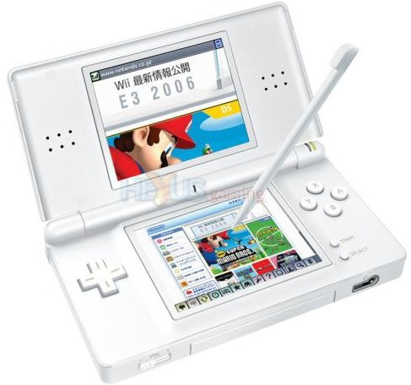






Activity
29
🟆 What are the key attributes for..
Interactive game | Banking system | Cardiac monitor in an ICU unit
Players, score, scenes, theme. | Client accounts, stocks bonds, money transfers. | heart rate, temperature, blood pressure.

Slide 52
Challenges facing software engineering
30
Challenge | Why? | Software needs to ..
Heterogeneity | Systems are distributed and include a mix of hardware and software.Different computers, different platforms, different support systems. | Cope with this variability.
Delivery | Businesses are more responsive → supporting software needs to evolve as rapidly. There is increasing pressure for faster delivery of software. | Be delivered in shorter time without compromising quality.
Trust | Software is a part of many aspects of our lives (work, study, leisure). Legacy systems (Old, valuable systems must be maintained and updated) | Demonstrate that it can be trusted by users.

Slide 53
Discuss
Why do we have to follow standard process when we make software? What would happen if we ignore the standard process?

Slide 54
End
31

